Slide 1
Standards & Regulations Presentation
ISO 10993 & ISO 13485
Team C: Kaushik Balasundar, Parker Hill, Anthony Kyu, Sundaram Seivur, Gunjan Sethi

Slide 2




ISO 10993
Biological Evaluation of Medical Devices

Slide 3
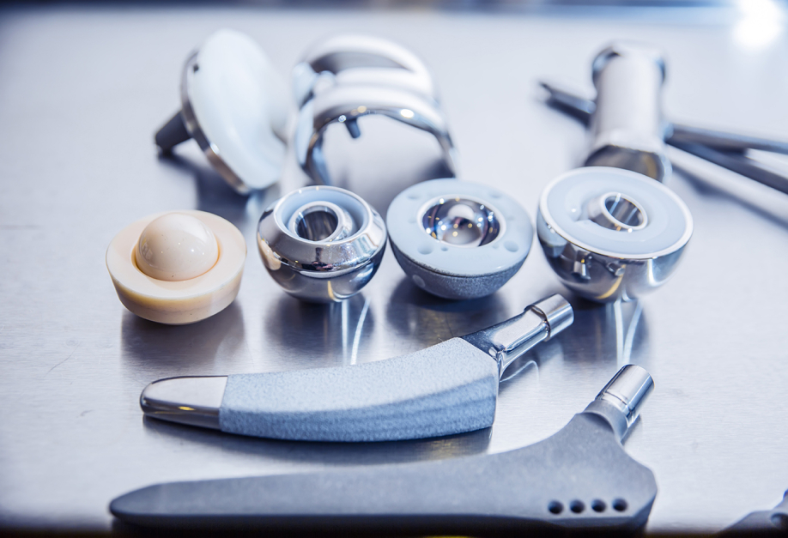
What is it about?
Goal: Protect humans from potential biological risks arising from the use of medical devices
Provides a framework in which to plan a biological evaluation and evaluate the resulting risks
Not a rigid test plan, experts must plan tests themselves
Evaluation should include consideration of:
Medical device geometry
Area of application
Materials
Physical and chemical characteristics
History of clinical or human use
Toxicology or biological safety data
Test procedures

Slide 4
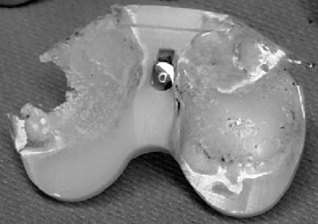
Why should we care? [Biocompatibility Issues]
Biocompatibility: ability of a medical device or material to perform with an appropriate host response in a specific application
Potential unwanted host responses could include blood clotting, inflammation, local tissue degradation, etc.
Furthemore, if a device is not biostable, it could lead to premature degradation due to wear
Medical Devices: any instrument, apparatus, implement, machine, appliance, implant, or reagent intended by a manufactured to be used on human beings for medical purposes

Slide 5
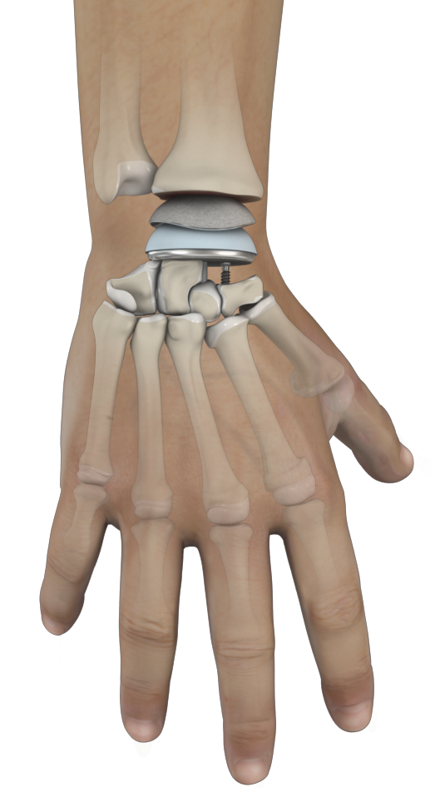

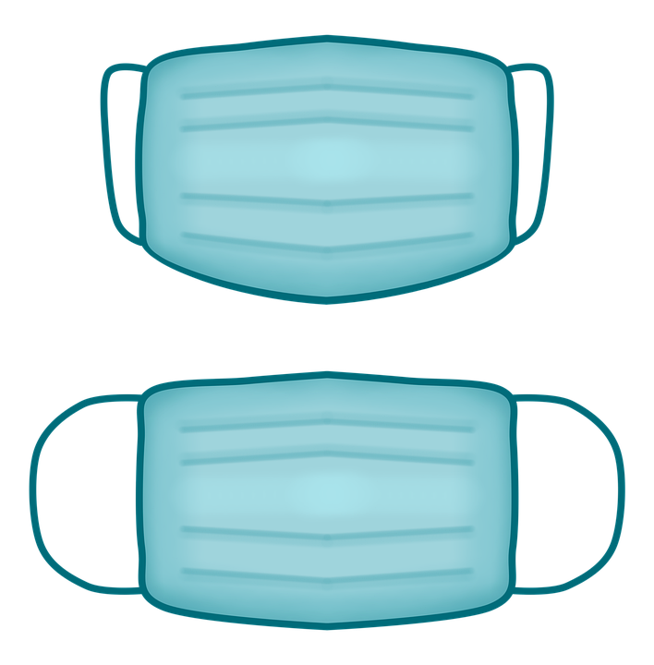

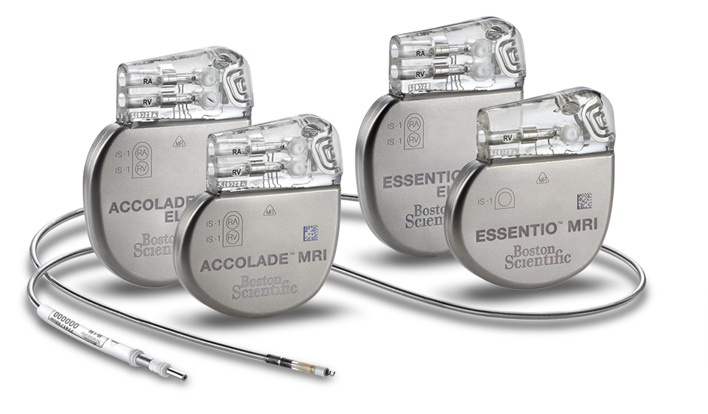

Product Application
Applies to evaluation of materials and medical devices that are expected to have direct or indirect contact with –
Nature of Contact
Non-contacting?
Surface only?
Externally communicating?
Implants?
Think about the product’s..
Patient’s Body
User’s Body
Duration of Contact
Upto 24 hrs?
24 hrs - 30 days?
> 30 days?
Transitory contant?

Slide 6
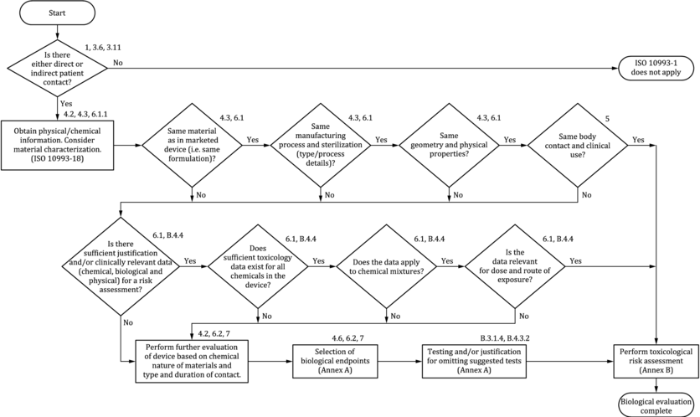
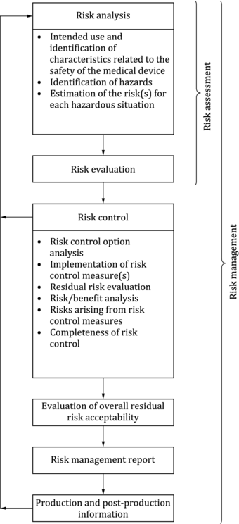
Main Prescriptions: Biological Evaluation and Risk Analysis

Slide 7
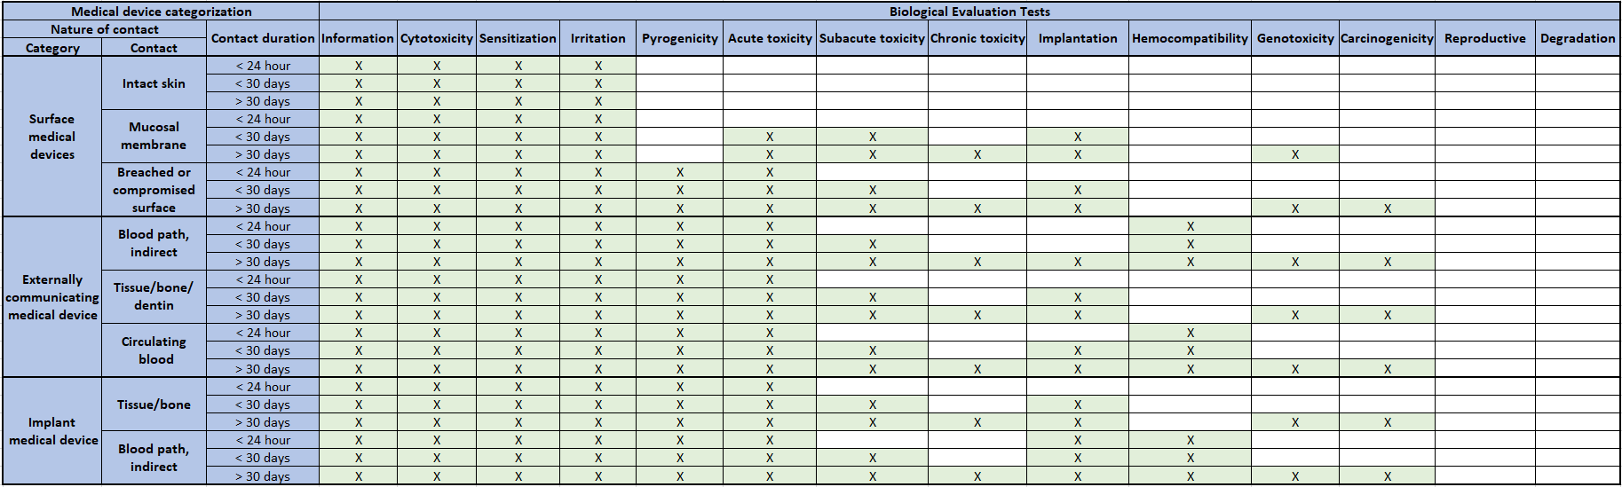
Main Prescriptions: Biological Tests

Slide 8
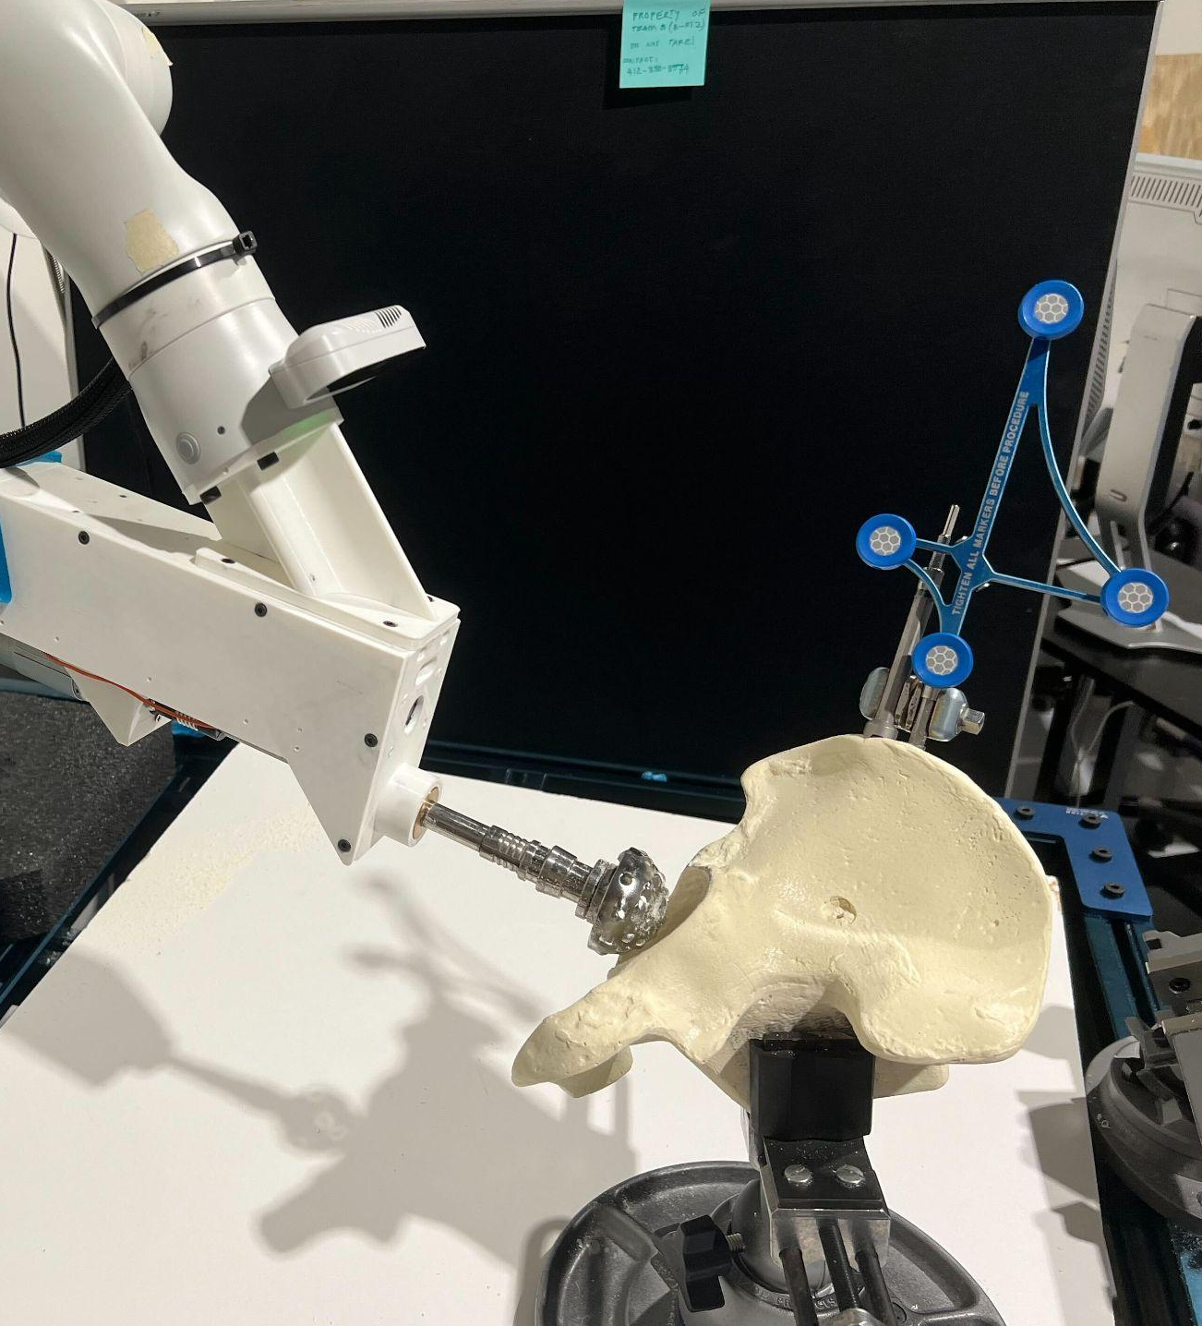
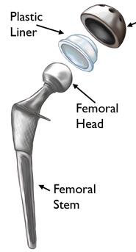
Application to ARTHuR
Components to test for biocompatibility:
Reamer head (stainless steel)
Marker holder (stainless steel)
Probe (stainless steel)
Other potential considerations for THR:
Femoral stem (coarse titanium)
Acetabular cup (coarse titanium)
Bone screws (stainless steel)
Femoral head (ceramic)
Inner acetabular cup (polyethylene)

Slide 9

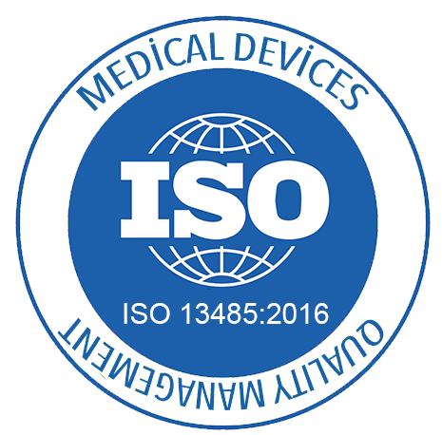
ISO 13485
Medical devices — Quality Management Systems

Slide 10
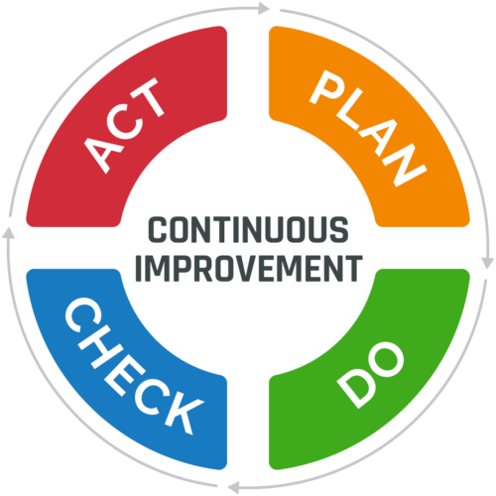
What is it about?
A quality management system (QMS) is a set of policies, processes and procedures that help an organization meet the requirements expected by its stakeholders.
ISO 13485 is designed to be used by organizations throughout the life cycle of a medical device, from initial conception to production and post-production, including final decommission and disposal.

Slide 11
Product Application
Conceptualization → Production → Post-production → Decommission → Disposal
It also covers aspects such as storage, distribution, installation and servicing, and the provision of associated services.
The standard can be used by internal and external parties, such as certification bodies, to help them with their certification processes, or by supply chain organizations that are required by contract to conform.
Applicable to a wide range of medical equipment such as wound dressings, implantable devices, and software controlled devices such as CT scanners etc.

Slide 12

Main Prescriptions: General Requirements
The organization shall
document a QMS and maintain its effectiveness
Apply a risk based approach to the control of the appropriate processes
Determine the sequence and interaction of these processes
When the organization chooses to outsource any processes, it shall monitor and ensure control over such processes
The organization shall document procedures for the validation of the application of computer software used in the quality management system

Slide 13

Main Prescriptions: Documentation Requirements
The quality management system documentation shall include:
a) documented statements of a quality policy and quality objectives;
b) a quality manual;
c) documented procedures and records required by this International Standard;
d) documents, including records, determined by the organization to be necessary to ensure the effective planning, operation, and control of its processes;
e) other documentation specified by applicable regulatory requirements.

Slide 14

Main Prescriptions: Management Responsibility
Top management commitment
Evidence of development, evidence and maintenance of QMS
Ensuring customer requirements development & compliance
Planning to establish quality standards at all levels & functions
Responsibility, authority and communication
Personnel who have authority to ensure compliance with quality standards
Reports structure
Appropriate communication structure to ensure traceability of issues
Procedures for management reviews
System to get reviews at all levels
Protocols for remedial outputs
Notes:
Top Management Commitment will need to ensure the following:
In the form of centralized meetings, address the importance of a QMS
Conducting reviews to ensure they are followed
Ensuring availability of resources
Protocol for meeting customer requirements
Legal bounds to commitment to quality policy
They will need to ensure customer requirements are gathered, developed and complied to. This also involves enforcing necessary requirements not specified by the customer
Planning before the beginning of a project to ensure that there is a plan of action on how to comply with regulations
They will also need to set in place dedicated personnel in charge of quality assurance at various functions. The report structure in place will need to be documented for traceability
They need to also place procedures for management reviews to receive feedback and carry out remedial actions

Slide 15


Main Prescriptions: Resource Management
Human resources
Training, skills & experience
Evaluate efficacy
Maintain records of procedures undertaken
Infrastructure
Buildings & workspaces
Equipment for quality measurement
Supporting physical & digital services
Work environment and contamination control
Protocols for health, cleanliness and clothing of personnel
Sterilization

Slide 16





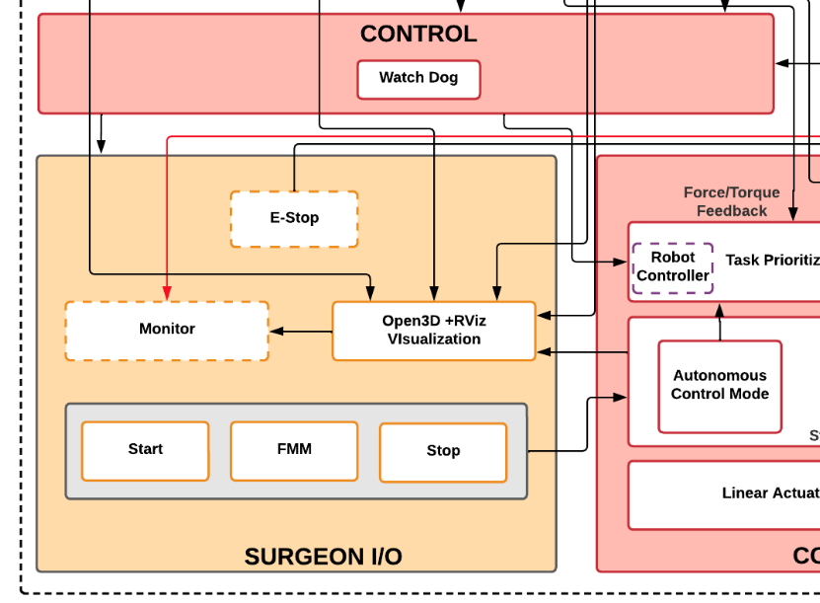
Application to ArTHUR
Project Planning
Requirements development, documentation, and maintenance
Trade studies
Customer interviews & expert consultation with surgeons
Project management efforts
Documentation control
Clear ownerships & accountability
Customer meetings and progress reviews
Issue logs and code reviews
System Validation and Verification
Exposing key system health & performance parameters
Evaluation metrics for each sub-system at various stages
Active watchdog sub-system for continuous monitoring & intervention
Controlled work environment, contamination control protocols, testing in later stages

Slide 17

i am biocompatible r u?
thanks!!!! ask me questions now.

